Slide 1
Measures of Central Tendency
R. Garner, DePaul University

Slide 2
What are they and what do they tell us?
These are numbers that summarize a distribution—a few numbers sum up the information.
Two major types of summary measures are measures of central tendency and measures of variability.
Measures of central tendency tell us about the center, middle point (or points), points of concentration or “congregating”; they tell us about similarity in the data or what the observations have “in common.”

Slide 3
Mean, median, and mode
These are the three major measures of central tendency.
In everyday speech, we might use words like “average,” “ordinary,” “middle of the road,” and “typical.”
People might refer to all three measures as “averages” although this word is often used as a synonym for the mean.
These three measures are very different from each other—we find them with very different procedures and the information they convey is different.

Slide 4
How are they different?
The arithmetic mean (“average”) includes the value of every case in the distribution. The value of the variable for every case has to be included in a calculation that determines the value if all the cases had equal values.
The median is the value at the middle point of the distribution when all the values are listed in order (ascending or descending order).
The mode is the most frequent value.

Slide 5
Three different operations
The logic for the three measures is different.
They answer three different questions:
Mean: what would be the value if all the cases had equal values for the variable?
Median: what is the value associated with the middle case of the distribution when they are lined up in order?
Mode: which is the most frequent value in the distribution?

Slide 6
When can we use which?
The mean can only be computed for a numerical variable. The values must be numbers (not code numbers).
The median can be found for numerical variables and ordinal categorical variables.
The mode can be found for all types of variables. It is the only measure of central tendency available for nominal-categorical variables.

Slide 7
Examples
Mean: mean height, mean weight, mean per capita income (of countries), mean crime rate for a sample of cities.
Median: median height, median weight, median per capita income of countries, median crime rate of cities, median ordinal category of “tall, medium, short” heights, median grades (of individuals) for a semester.
Mode: mode of religious affiliation of university students, mode of a set of food choices in a marketing survey.

Slide 8
The mean
The procedure for finding the mean is the most “calculational” of the three procedures.
Add up all the (numerical) values, one for every case in the distribution. This step produces a large sum.
Divide the large sum by the number of cases.
The quotient is the mean.

Slide 9
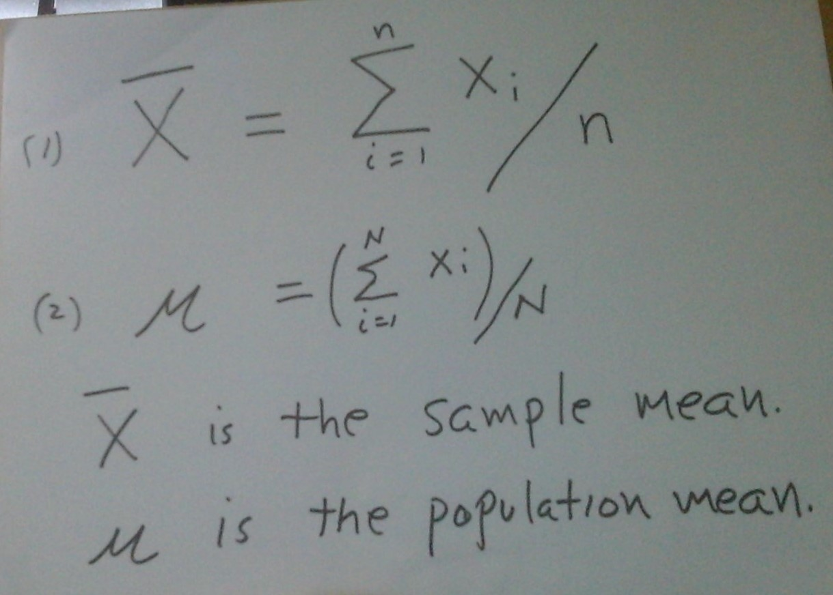
Formula for the mean

Slide 10
Formula for the mean: symbols
We might be computing the mean for a sample (e.g., heights of a sample of students) or for a population (e.g., all students at our university). These means are computed the same way but have different symbols—the funny X-bar for the sample, and the Greek letter lower-case mu, μ, for the population.

Slide 11
Sum of the values, followed by division
In the denominator of the division, we can see a big Greek letter, a capital sigma, Σ, and that stands for an operation “add up everything that follows.” We are going to add up all the values of the variable, one for each case. The cases are numbered 1 through n (or N, if this batch is the population), and the little x stands for the value of an observation.
We end up with a sum of all the values (e.g., heights of all the students)
Then we divide the sum by the number of cases.

Slide 12
The median
We find the median by lining up all the observations, with a value for each case in the distribution, in order.
THEY MUST BE ARRANGED IN ORDER, either ascending or descending. Do NOT forget this step—in your data file, the values might not be in any order, and they must be put in order before you can find the median.
Then find the middle observation (or if there is an even number of cases, the arithmetic mean of the two middle values). That number is the median.

Slide 13
The median and percentiles of a distribution
The median is associated with the percentiles of a distribution.
It is the value (observation) at the 50th percentile.
Notice this procedure is based on an order of the values (ascending or descending)—they must be numerical or ordinal, so that we can line them up and talk about “being halfway through the cases.”

Slide 14
Ordinal data: the median
The procedure on the previous slide sounds numerical, but we can use it for ordinal data as well.
Line up all the values in the order of the categories. For example: small, medium, large; high-income, higher-mid income, lower-mid income, low income; XXL, XL, L, M, S, XS, XXS; grades of A through F.
Look to see which category the middle case falls into. That is the median (name or code number of a category).

Slide 15
The mode
The mode is the value with the highest frequency.
This value could be a number (if the variable is numerical) or it could be a category (if the variable is categorical).
The modal frequency is the number of cases associated with the mode. The mode is a value in the distribution; the modal frequency is the number (or percentage) of cases.
In a bar chart or histogram, we can see the mode: it is the highest vertical bar.

Slide 16
Monkey Business!
It is easy to play games with measures of central tendency, reporting only the one that supports your claim.
We should always be able to see all of them.
If a variable distribution is highly skewed, we MUST show both the median and mean. These two measures of central tendency will be different.
The mean will be pulled up (positive skew) or down (negative skew) by the small number of extreme values.

Slide 17
Question 1
Think of examples of data sets (distributions) for finding means, medians, and modes. For which of your examples can we find all three measures? Only the mode? The mode and the median, but not the mean?

Slide 18
Question 2
Can you make up (or find online) an example in which the median and the mean are very different?

Slide 19
Question 3
We are looking at a sample of student transcripts.
How would we find the median grade for a semester for all these students?
How would we do it for each individual student?
How would we do it for the whole sample?
How would finding the median be different from finding the GPA? How are the steps different? How would the interpretation be different?

Slide 20
Question 4
In the discussion of global warming, we often hear that the Paris Agreement of 2015 set the goal of keeping mean global temperature rise in our century to less than 2 degrees Celsius and preferably below 1.5 degrees.
This seems like a fairly small target number—why is the mean hard to attain?

Slide 21
Question 5
Before the Revolution, the count owned 50 pairs of shoes, the countess owned 50 pairs of shoes, the overseer owned 3 pairs, and the 100 peasants were all shoeless.
After the Revolution, the Mean Commissar checks conditions on the estate, and he is told: “Everything is fine here! We have one pair of shoes per capita, so no problem!” What do you think?

Slide 22
Key Terms
Summary measures; measures of central tendency; mean; median; mode; 50th percentile; median for ordinal data; modal frequency; summation operator (Σ); symbols for sample mean (X-bar) and population mean (μ).

